Slide 1

DATA ANALYSIS comparison of median numbers of heterozygotes for all locus of healthy and diseased Holstein-Friesian cows
Author:
Szymon Armata

Slide 2


Purpose of the work
verification of biological hypotheses
comparison of functions: high-throughput and sequential versions
analysis and interpretation of the results obtained

Slide 3
Import libraries
library(data.table)
library(parallel)
library(dplyr)

Slide 4
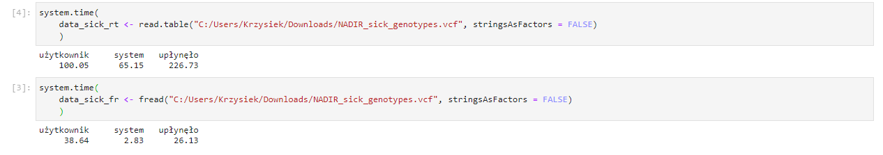
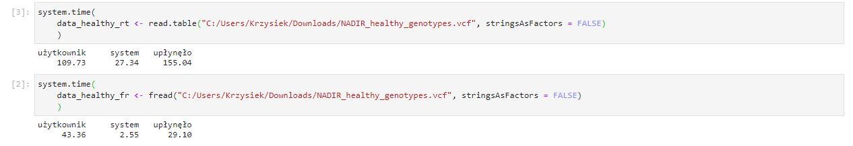
Import data
Data of diseased H-F cows:
Data of healthy H-F cows:

Slide 5
Import data
Data of diseased H-F cows:
Data of healthy H-F cows:

Slide 6
Import data
Data of diseased H-F cows:
read.table fread
226.73 > 26.13
Data of healthy H-F cows:
read.table fread
155.04 > 29.10

Slide 7

Import data
}
chose fread function, because it’s faster in this two cases
Data of diseased H-F cows:
read.table fread
226.73 > 26.13
$$⇒$$
Data of healthy H-F cows:
read.table fread
155.04 > 29.10

Slide 8
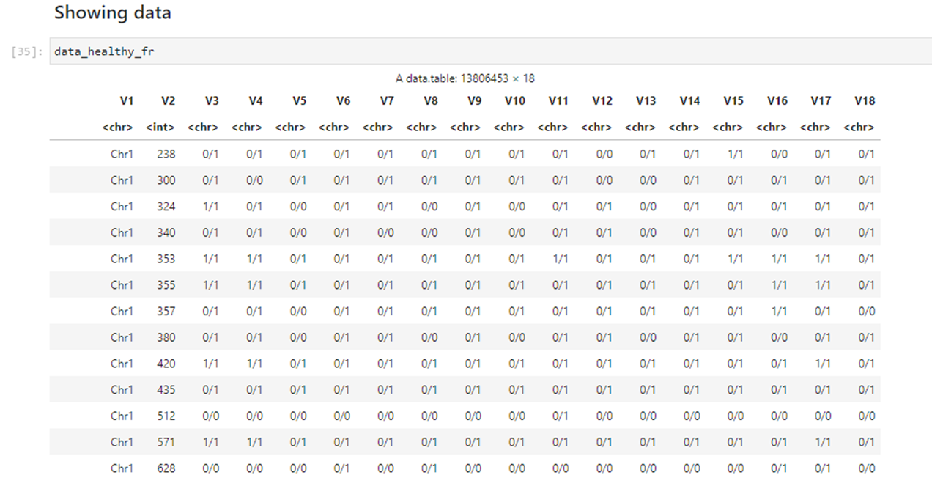
Import data
Data of healthy H-F cows:

Slide 9
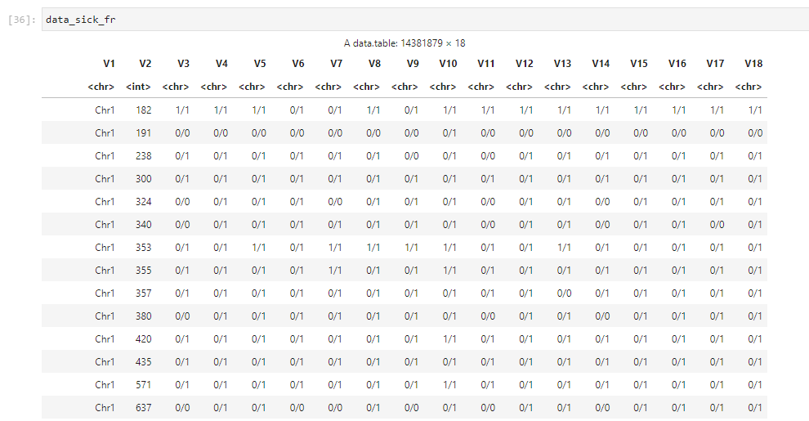
Import data
Data of diseased H-F cows:

Slide 10
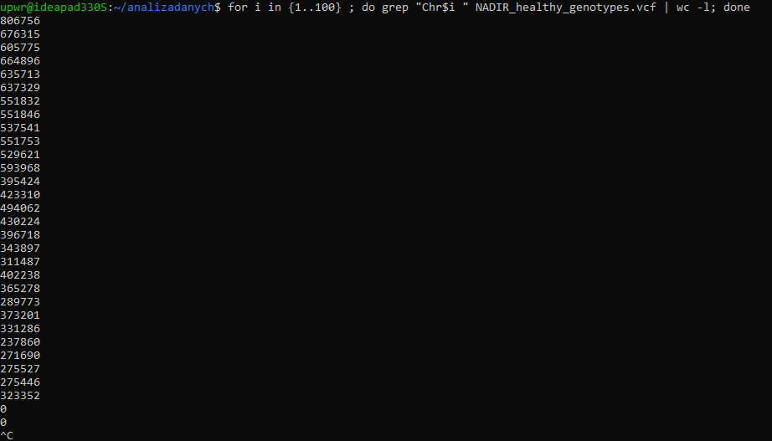
checking the number of chromosomes - bash
Chromosom 1
Chromosom 2
Chromosom 3
data of healthy H-F cows
.
.
.
Chromosom 29

Slide 11
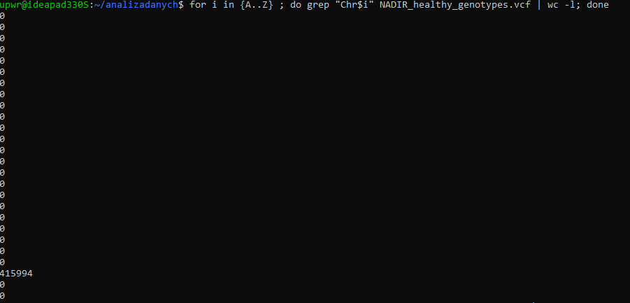
checking the number of chromosomes - bash
Data of healthy H-F cows
A
B
.
.
.
X

Slide 12
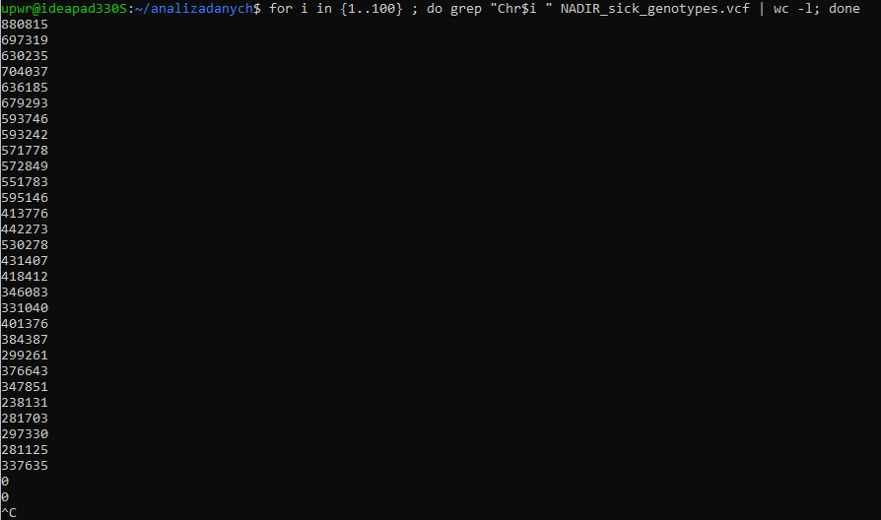
checking the number of chromosomes - bash
Chromosom 1
Chromosom 2
Chromosom 3
data of diseased H-F cows
.
.
.
Chromosom 29

Slide 13
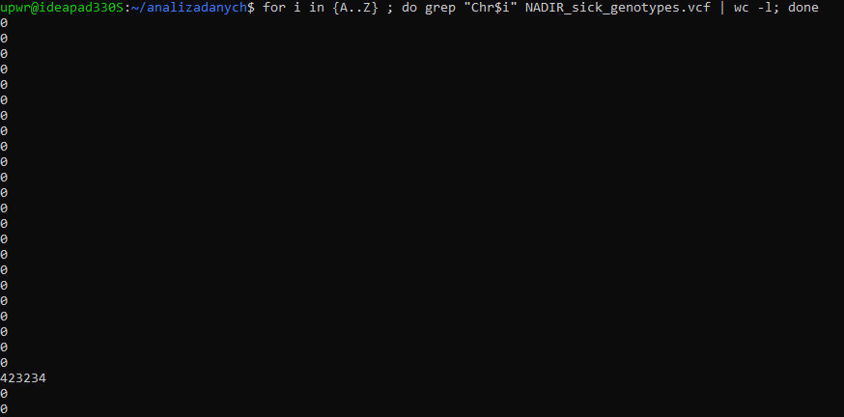
checking the number of chromosomes - bash
Data of diseased H-F cows
A
B
.
.
.
X

Slide 14
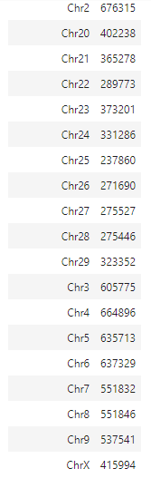

checking the number of chromosomes - R
Data of healthy H-F cows

Slide 15
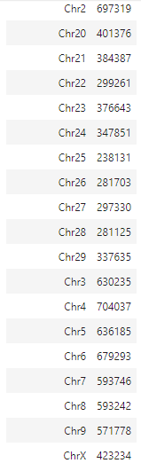

checking the number of chromosomes - R
Data of diseased H-F cows

Slide 16
counting the number of chromosomes
results obtained with BASH and R gave consistent values
the R package proved more convenient, as it immediately listed chromosomes starting with a number as well as a letter

Slide 17
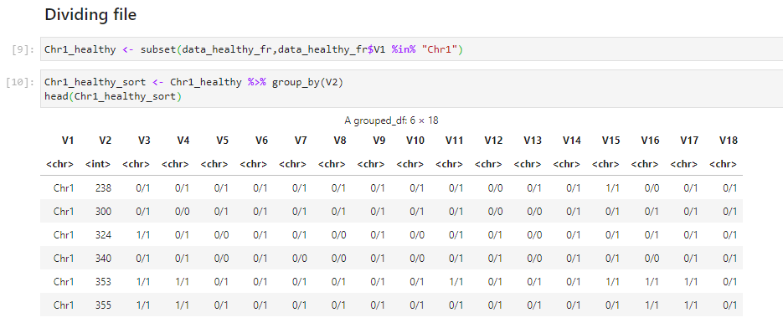
SORTING & CLUSTERING
Data of healthy H-F cows
clustering variable

Slide 18
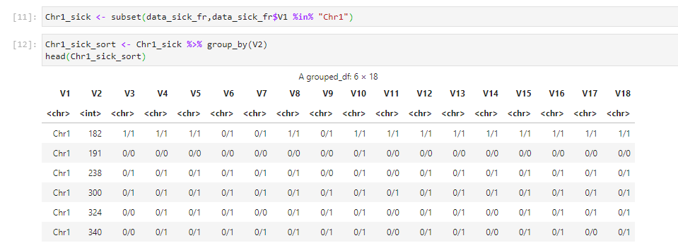
SORTING & CLUSTERING
Data of diseased H-F cows
clustering variable

Slide 19
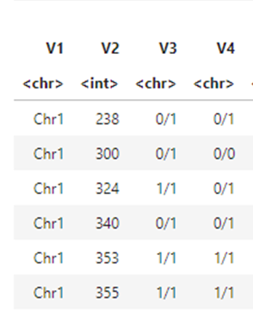
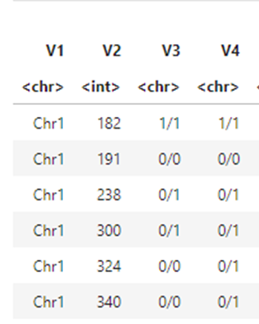
merging DATA.FRAME
Data of healthy H-F cows
Data of diseased H-F cows

Slide 20
merging DATA.FRAME
some records do not match
in order to perform a comparative analysis, it is necessary to match the same locus

Slide 21
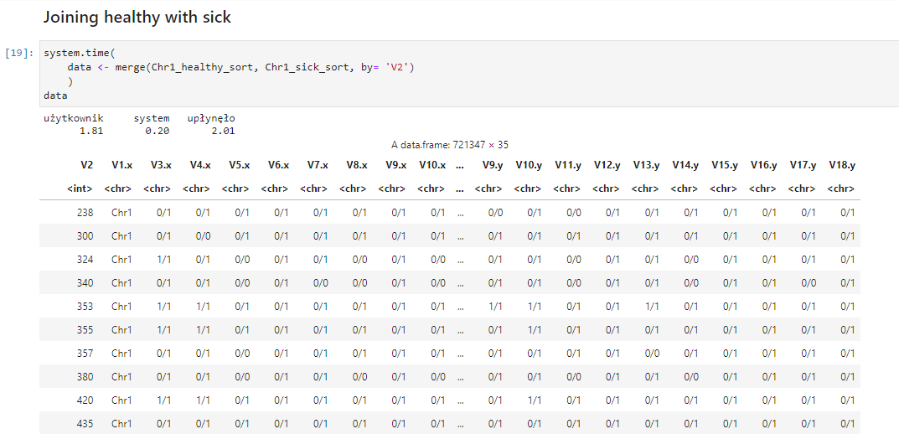
Merging DATA.FRAME – MERGE function
współna

Slide 22
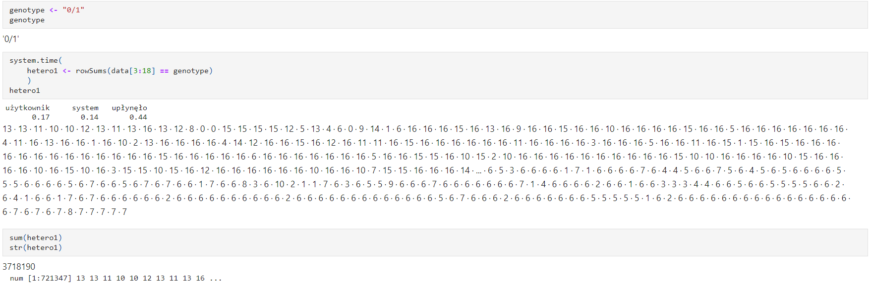
sum of heterozygotes – merged file
Data of healthy H-F cows

Slide 23
sum of heterozygotes – merged file
Data of healthy H-F cows

Slide 24
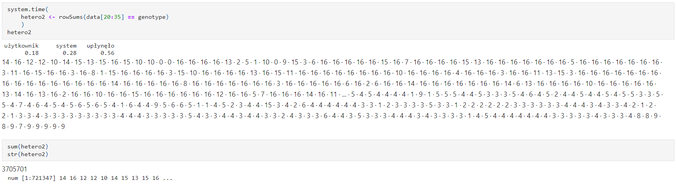
sum of heterozygotes – merged file
Data of diseased H-F cows

Slide 25
sum of heterozygotes – merged file
Data of diseased H-F cows

Slide 26
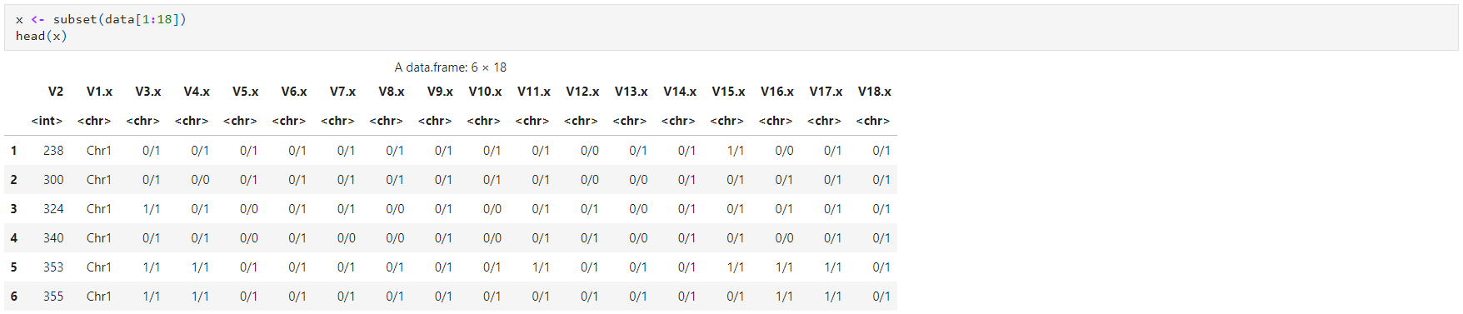
sum of heterozygotes – split file
Data of healthy H-F cows

Slide 27
sum of heterozygotes – split file
Data of healthy H-F cows

Slide 28
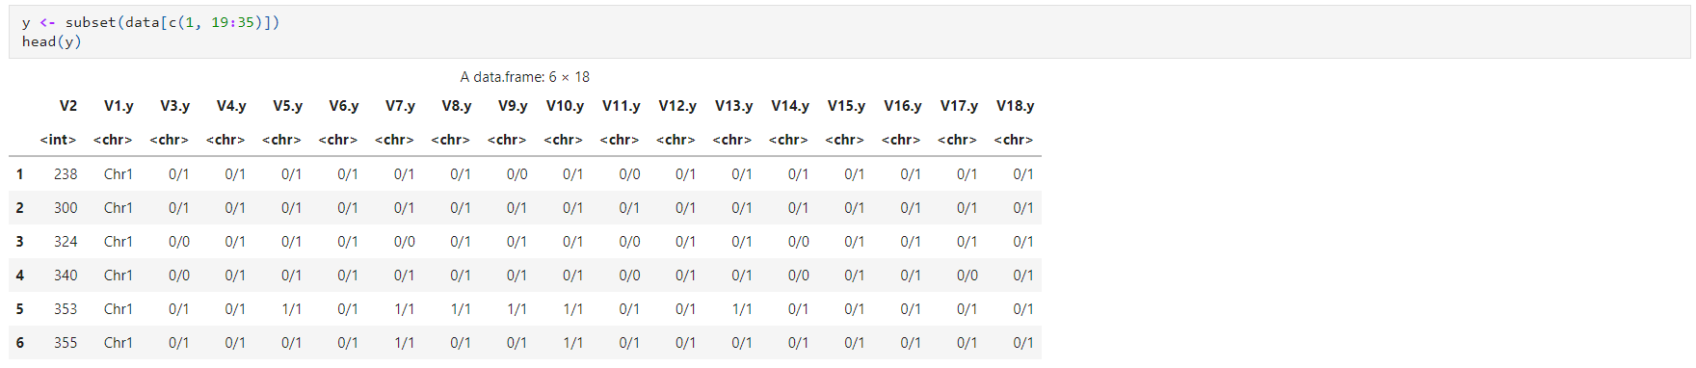
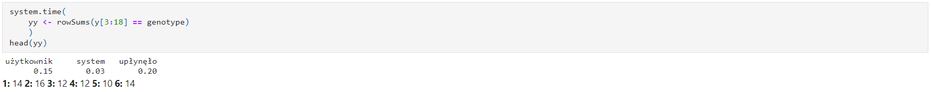
sum of heterozygotes – split file
Data of diseased H-F cows

Slide 29
sum of heterozygotes – split file
Data of diseased H-F cows

Slide 30

sum of heterozygotes
}
for split files, the total count was considerably faster
merge function made it possible to extract records for the same locus in both tables, but working on the merged file would be slower
decision: leave the split files and continue working on them
Data of healthy H-F cows
merged file split file
0.44 > 0.25
$$⇒$$
Data of diseased H-F cows
merged file split file
0.56 > 0.20

Slide 31
hypothesis testing
Verification of the equivalence of groups
Checking the normality of the distribution
Checking for homogeneity of variance
Selection of the test for independent groups

Slide 32
hypothesis testing
Verification of the equivalence of groups
Checking the normality of the distribution
Checking for homogeneity of variance
Selection of the test for independent groups

Slide 33
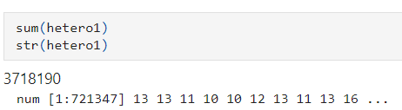
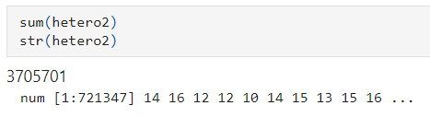
EQUIVALENCE OF THE GROUPS
Data of healthy H-F cows
Data of diseased H-F cows
721347 = 721347
The groups are of equal size.

Slide 34

hypothesis testing
Verification of the equivalence of groups
Checking the normality of the distribution
Checking for homogeneity of variance
Selection of the test for independent groups

Slide 35
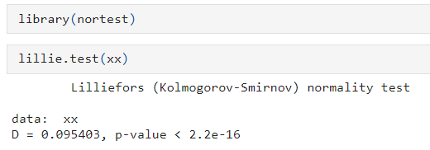
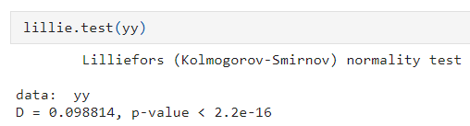
Normality of distribution
Data of healthy H-F cows
H0: The data have a normal distribution.
H1: The data have a non-normal distribution.
p-value < 2.2e-16 < 0.05
reject H0, accept H1
Data of diseased H-F cows
H0: The data have a normal distribution.
H1: The data have a non-normal distribution.
p-value < 2.2e-16 < 0.05
reject H0, accept H1

Slide 36
Normality of distribution
Data of healthy H-F cows
H0: The data have a normal distribution.
H1: The data have a non-normal distribution.
p-value < 2.2e-16 < 0.05
Data of diseased H-F cows
H0: The data have a normal distribution.
H1: The data have a non-normal distribution.
p-value < 2.2e-16 < 0.05

Slide 37
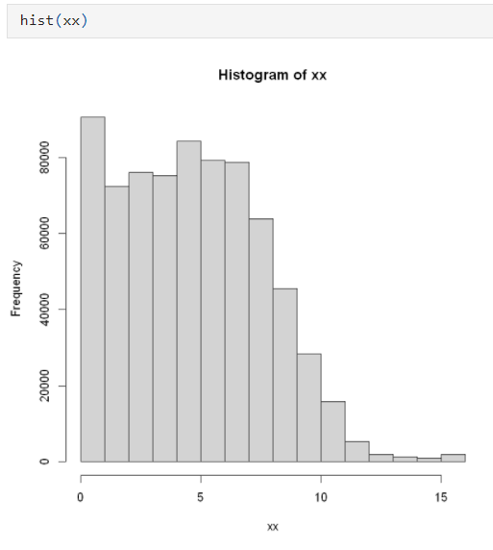
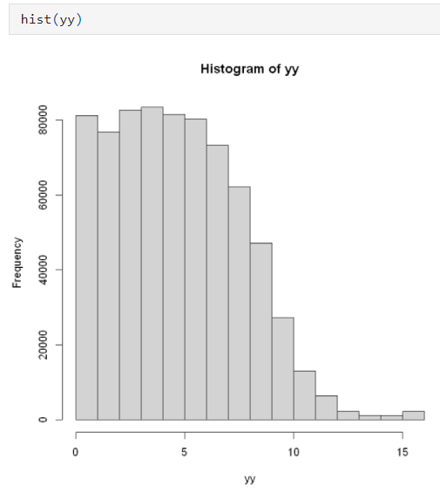
Normality of distribution
Data of healthy H-F cows
Data of diseased H-F cows

Slide 38

hypothesis testing
Verification of the equivalence of groups
Checking the normality of the distribution
Checking for homogeneity of variance
Selection of the test for independent groups

Slide 39
hypothesis testing
Verification of the equivalence of groups
Checking the normality of the distribution
Checking for homogeneity of variance
Selection of the test for independent groups
no normality of distribution - do not perform

Slide 40
hypothesis testing
Verification of the equivalence of groups
Checking the normality of the distribution
Checking for homogeneity of variance
Selection of the test for independent groups
no normality of distribution - do not perform

Slide 41
hypothesis testing
Verification of the equivalence of groups
Checking the normality of the distribution
Checking for homogeneity of variance
Selection of the test for independent groups
no normality of distribution - do not perform
Mann – Whitney test

Slide 42
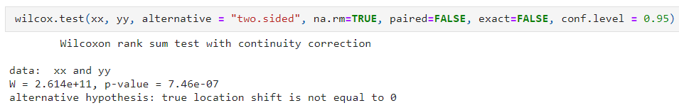
manna-whitney test
Data of healthy and diseased H-F cows
H0: The median numbers of heterozygotes for all locus of healthy and diseased individuals are equal.
H1: The median numbers of heterozygotes for all locus of healthy and diseased individuals are not equal.
p-value = 7.46e-07 < 0.05
reject H0, accept H1

Slide 43
Test manna-whitneya
Data of healthy H-F cows i chorych
H0: The median numbers of heterozygotes for all locus of healthy and diseased individuals are equal.
H1: The median numbers of heterozygotes for all locus of healthy and diseased individuals are not equal.
p-value = 7.46e-07 < 0.05

Slide 44
SUMMARY AND CONCLUSION
smaller data containing only genotypes was used - the specification of the equipment did not allow for more
way of loading data with fread was a better solution than read.table in this case
merge (inner) made it possible to combine data from two data.frames for the corresponding locus positions
an idea of the analysis is presented using the example of Chr1 - analogous further steps can be performed for the other chromosomes
the analyses led to the conclusion that the median numbers of heterozygotes for all locus of healthy and diseased individuals are not equal

Slide 45
BIBLIOGRAPHY
P. Biecek, Przewodnik po pakiecie R, 2014
P. Biecek, Analiza danych z programem R, 2013
J. Bartos, W. Dyczka, K. Królikowska, M. Wasilewski, W. Krysicki,
Rachunek prawdopodobieństwa i statystyka matematyczna w zadaniach 2, 2017

